Slide 1

AERO62520 Robotic Systems Design Project Design Requirements Analysis
639716

Slide 2


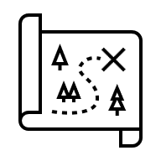



Design Requirements Process
Stakeholder Engagement
Problem Statement
Concept of Operations (CONOPS)
Functional Requirements
Performance Requirements
Requirements Verification Matrix

Slide 3
Stakeholder Engagement
Purpose: To understand what the customer actually wants.
Process: Conversation(s) with (all) the stakeholders to understand all aspects of the problem.

Slide 4
Example Template
Task Title |  | Problem Statement Ver.
Task Description (What needs doing, where does it need doing, is it currently done and if so how and how often, Any Hazards?)
Key Quantitative Requirements: (Example: The robot shall detect cracks of width >3mm )
Challenges: (what are the issues that need to be overcome?)
Additional Notes

Slide 5
Problem Statement
Purpose: To clearly describe what the problem is in high-level terms.
Process: Write a single statement which covers the who, what, where and why of the problem.

Slide 6
Example Problem Statement
Pipe networks are essential components of modern infrastructure systems. Ensuring the health and integrity of these pipelines is critical.
There is a growing interest in developing robot platforms that can traverse more complex environments, though none have yet been developed to handle heavily congested pipe networks.
A robot designed for this purpose can significantly enhance the efficiency and safety of pipe inspections.
By eliminating the need for scaffolding, the robot can perform inspections without necessitating facility shutdowns, reducing downtime and maintaining continuous operations. The use of robots minimises the exposure of human workers to hazardous conditions, enhancing overall safety.

Slide 7
Concept of Operations (CONOPS)
Purpose: A high-level description of how the proposed system will work that can be understood by the stakeholders and designers.
It creates a shared vision of what the system should do, ensuring there is no misunderstandings between the stakeholders and the designers.
Process: There’s no single way to develop a CONOPs, but often it includes a time-based description of the proposed system, such as a state machine, flowchart, or graphical display.

Slide 8

CONOPs Example

Slide 9
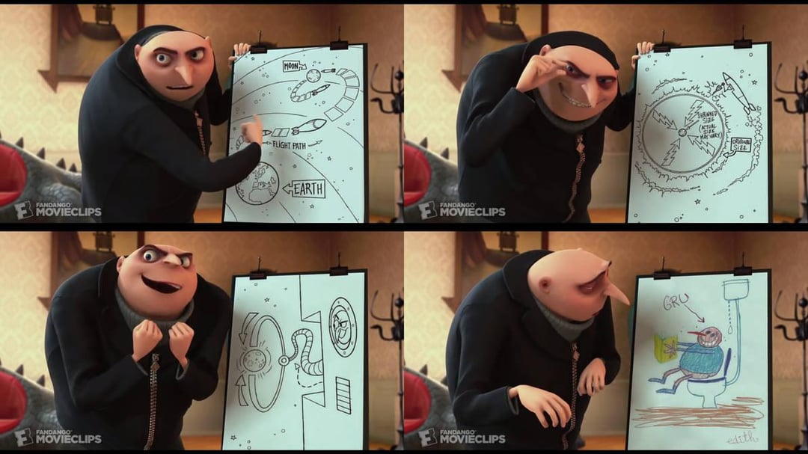
CONOPs Example

Slide 10
Functional Requirements
Purpose: These requirements define what high-level capabilities are needed to meet the objectives set out in the problem statement.
Language is very important [1]:
Shall = Requirement
Will = Facts or declaration of purpose
Should / May = Goal
[1] Appendix C of NASA Systems Engineering Handbook

Slide 11
Functional Requirements Example
The shape shall have four sides
The shape shall have four right angles

Slide 12
Performance Requirements
Purpose: Based on the Functional Requirements, these requirements define how well the system needs to perform. You can define a range of sub-categories to capture these requirements e.g.:
Performance requirements
Reliability requirements
Size, shape, mass, and style requirements
Cost requirements
Manufacturing requirements
Industry standards
Government regulations
Intellectual Property (IP) requirements
Sustainability requirements
Operational environment requirements
Pfeifer, Michael. (2009). Materials Enabled Designs - The Materials Engineering

Slide 13
Performance Requirements Example
The shape shall have four sides
1.1 The sides shall have equal length
The shape shall have four right angles

Slide 14
Requirements Verification Matrix
Purpose: To demonstrate how you verify that your design meets the requirements
Requirement No. | Shall Statement | Verification Success Criteria | Verification Method | Responsible Party | Results
1
2
3

Slide 15
RVM Example
Requirement No. | Shall Statement | Verification Success Criteria | Verification Method | Responsible Party | Results
1 | Have 4 sides | The shape has 4 sides | Count the number | SW
1.1 | Sides are of equal length | All sides are equal length | Measure the lengths | SW
2 | Have 4 right angles | There are 4 right angles | Count the number | SW

Slide 16
Importance of Details
Requirement No. | Shall Statement | Verification Success Criteria | Verification Method | Responsible Party | Results
1 | Have 4 sides | The shape has 4 sides | Count the number | SW | Yes
1.1 | Sides are of equal length | All sides are equal length | Measure the lengths | SW | Yes
2 | Have 4 right angles | There are 4 right angles | Count the number | SW | Yes(ish)

Slide 17
Performance Requirements In Detail
The shape shall have four sides
1.1 The sides shall have equal length
1.2 Each side shall be straight
1.3 Opposite sides shall be parallel with each other
The shape shall have four right angles
2.1 The right angles will all be internal
2.2 The sum of the interior angles shall be 360
The shape shall be symmetrical
3.1 There shall be four lines of symmetry
3.2 The rotational symmetry order shall be four

Slide 18
Design Requirements Analysis Coursework
Problem Statement (10%)
Concept of Operations (30%)
Functional Requirements (20%)
Performance Requirements (20%)
Requirements Verification Matrix (20%)

